Slide 1

Industry Visit to Daikin Industries
Exploring Business Operations & Data Management
Work Done By: Muskan S Bohra
Roll No. : 055025(BDA)

Slide 2
Daikin Industries: An Introduction
Global Leader
Indian Presence
Objectives
Founded in 1924, Daikin is a global leader. They specialize in air conditioning and HVAC systems.
Daikin has manufacturing plants and R&D centers in India. They cater to both domestic and international markets.
To understand the manufacturing process and technology used. Analyze data management for key operations.

Slide 3
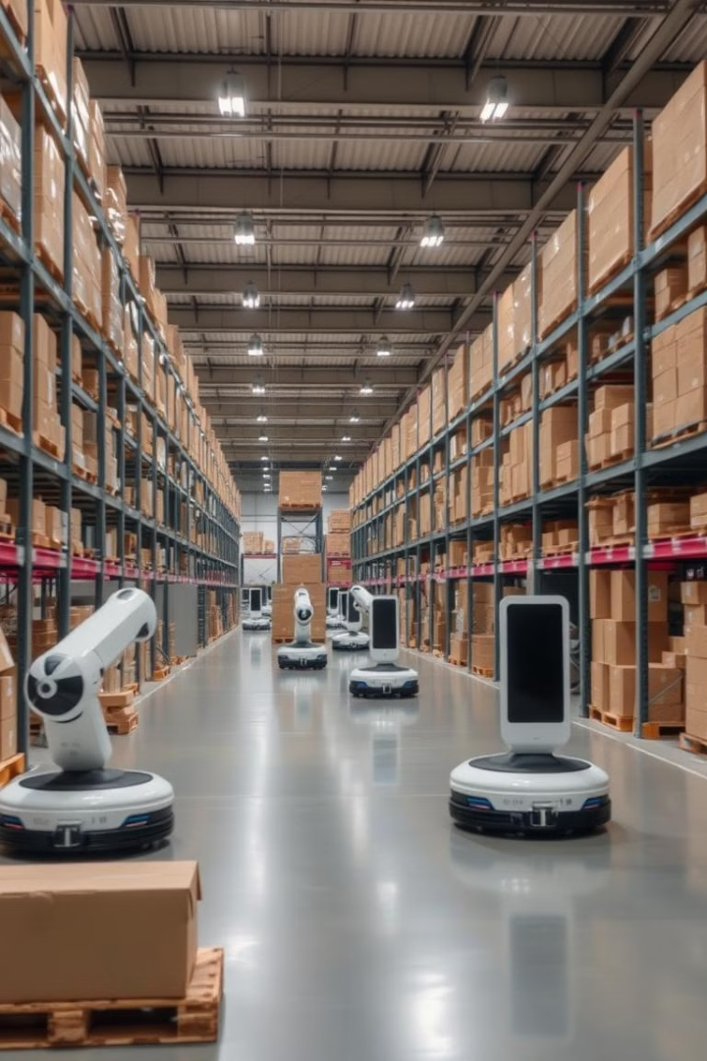
Key Business Processes
1
Order Processing
2
Inventory Management
Customers place orders through dealers or directly. ERP software tracks orders in real-time.
Daikin uses Just-in-Time (JIT) inventory to minimize stock. Warehouses are strategically located.
3
Customer Service
Service requests include installation and maintenance. A CRM system manages queries and service history.

Slide 4
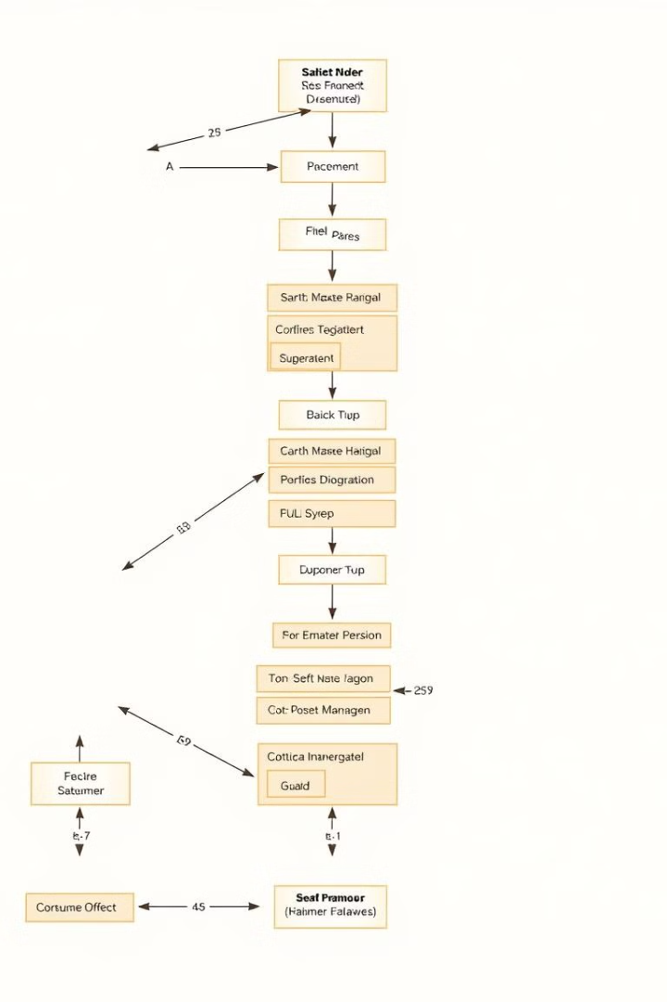



Entity Relationship Diagram (ERD)
Orders, Customers, Payments, Shipments: Handle customer transactions efficiently.
Products, Inventory, Warehouses: Manage stock levels and logistics effectively.
Suppliers & Supplier Orders: Ensure raw material availability for production.

Slide 5




Recommendations for Improvement
Data Automation
1
Predictive AI
2
4
IoT
3
AI Chatbots
Daikin can improve by automating data entry and validation. AI can predict equipment failures. AI chatbots can enhance customer interactions. IoT can track shipments in real-time.

Slide 6




Observations & Insights
Streamlined Operations
Daikin efficiently connects order processing and inventory. Digital systems minimize errors.
Data Management
Normalization in databases reduces redundancy and increases speed. ERP and CRM are integrated.
Customer-Centric
Fast response times via automated technician assignments. Payment and shipment tracking enhance transparency.

Slide 7
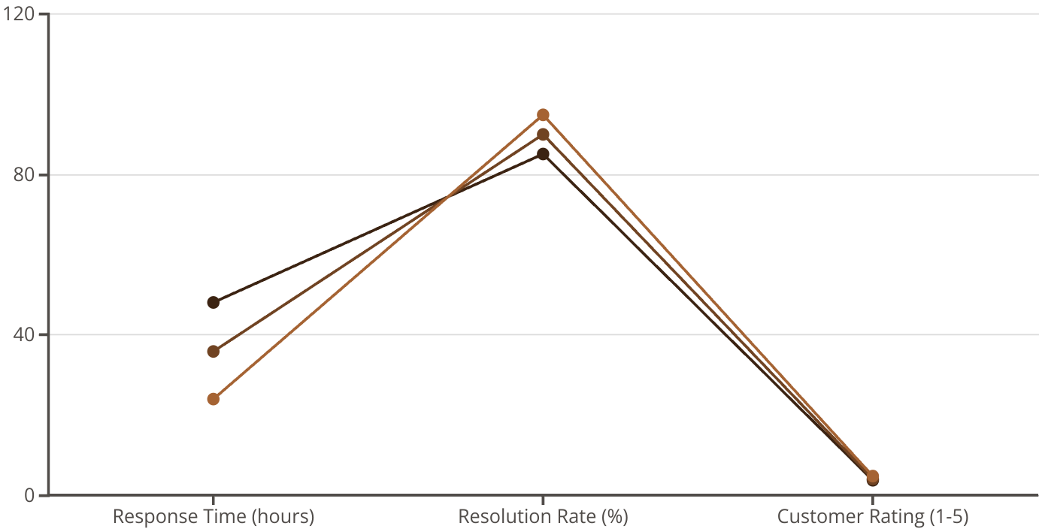
Customer Satisfaction Metrics
2022
2023
2024
Improved customer satisfaction through faster response times. Increased issue resolution rates, and higher customer ratings.

Slide 8

Conclusion
Valuable Insights
Visual Data
The visit offered valuable insights into Daikin's tech integration.
The ERD helped visualize complex data interactions clearly.
Continuous Growth
Innovation can further enhance efficiency and customer service.

